Slide 1


Continuous-Time
Approximate Dynamic Programming
as an Active Learning Problem
Master Thesis presentation
Balduin Dettling
Supervision: Lenart Treven, Bhavya Sukhija, Andreas Krause, Florian Dörfler

Slide 2
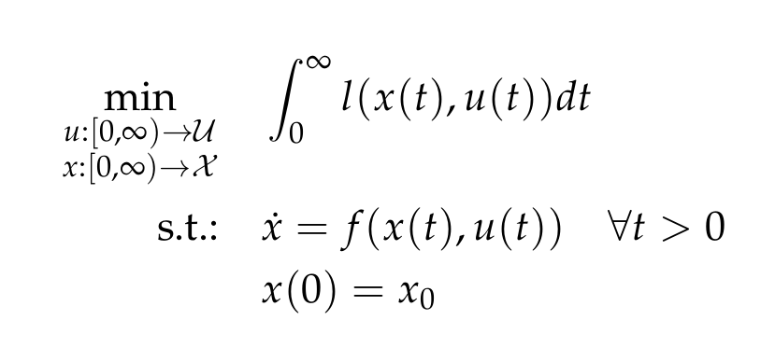
Optimal Control
For a dynamical system ẋ = f (x, u), find:
Notes:
Highlight:
f, l perfectly known
Horizon infinite, no discount (conditions for existence of sol)

Slide 3
Optimal Control Theory Crash Course
Problem is solved by value function V(x)
Optimal input recovered from value gradient V_{x}(x)
V is the viscosity solution the HJB equation
Locally optimal trajectories: PMP

Slide 4
Numerical methods for Optimal Control
Trajectory optimisation
  Only locally optimal solution
  Accurate approximation of continuous-time solution
“Dynamic Programming”
  As in: Find V that satisfies HJB equation
  Global optimality
  Practical methods immature
Goal: Practical numerical method that does both

Slide 5
Global Optimality in continuous time?
Decompose problem:
Generate large set of locally optimal trajectories
Extract approximate knowledge of globally optimal control law

Slide 6
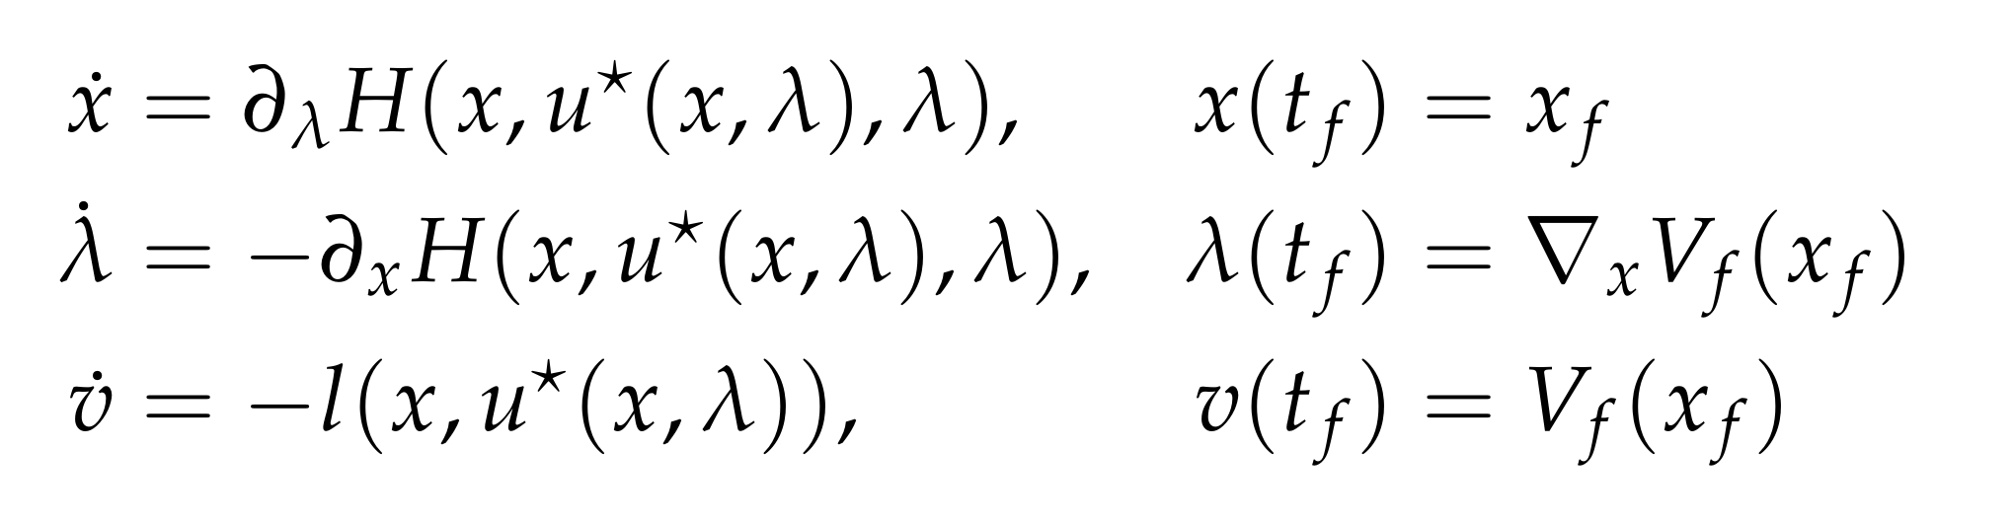
Trajectory Generation
Pontryagin’s Minimum Principle

Slide 7
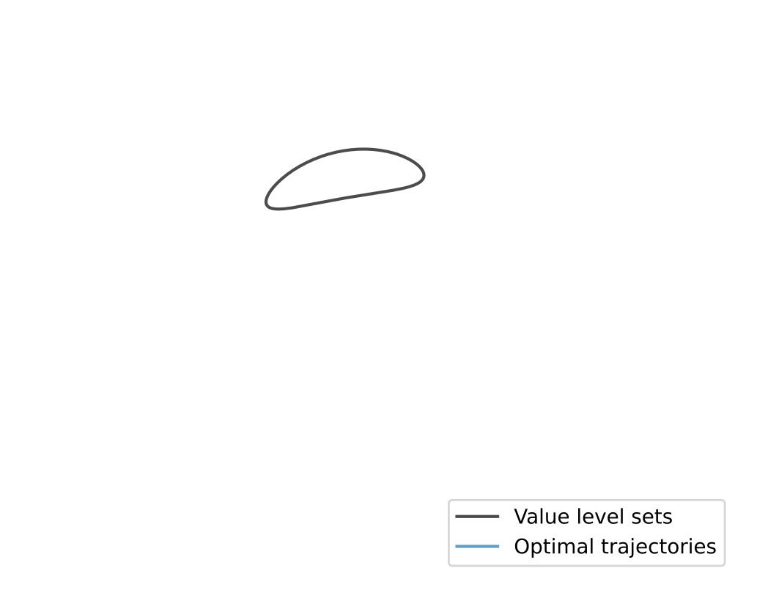
Trajectory Generation

Slide 8
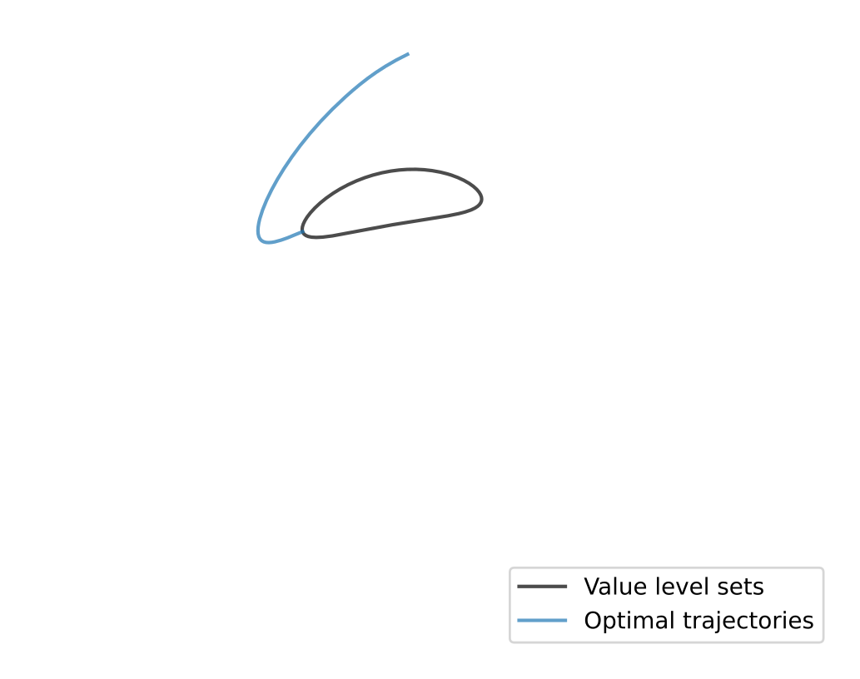
Trajectory Generation

Slide 9
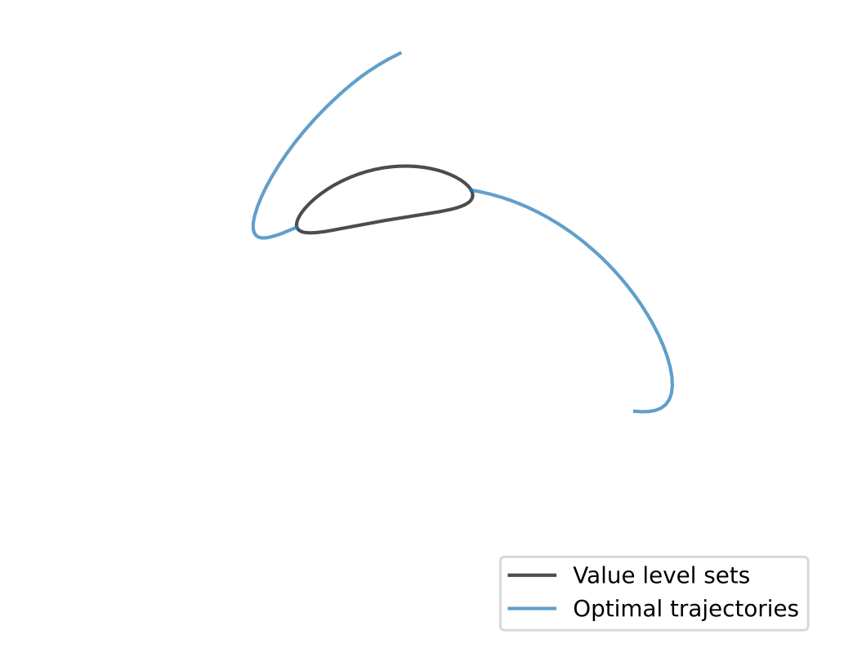
Trajectory Generation

Slide 10
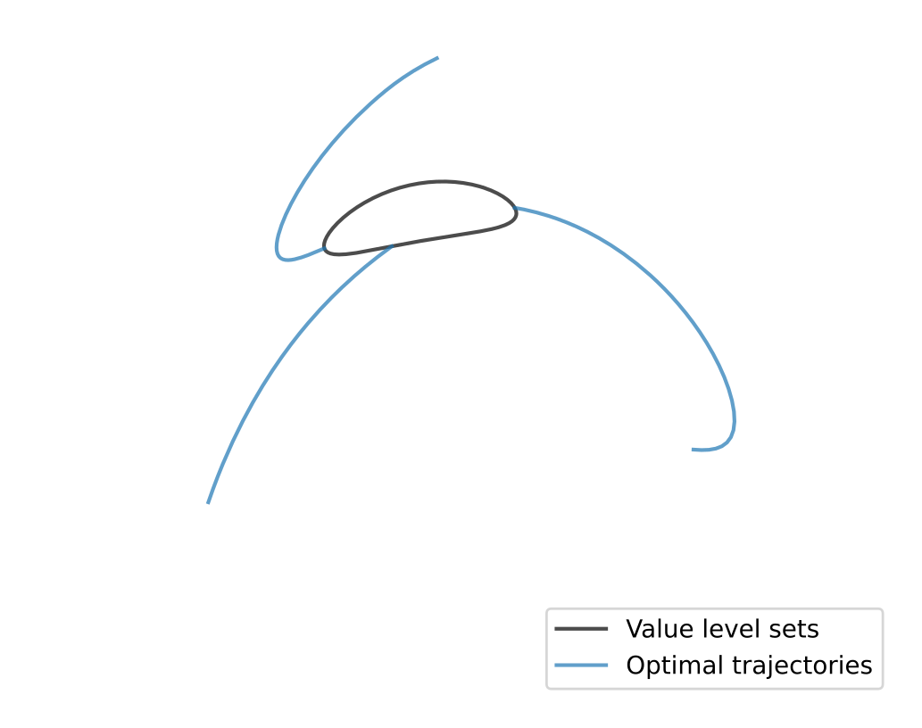
Trajectory Generation

Slide 11
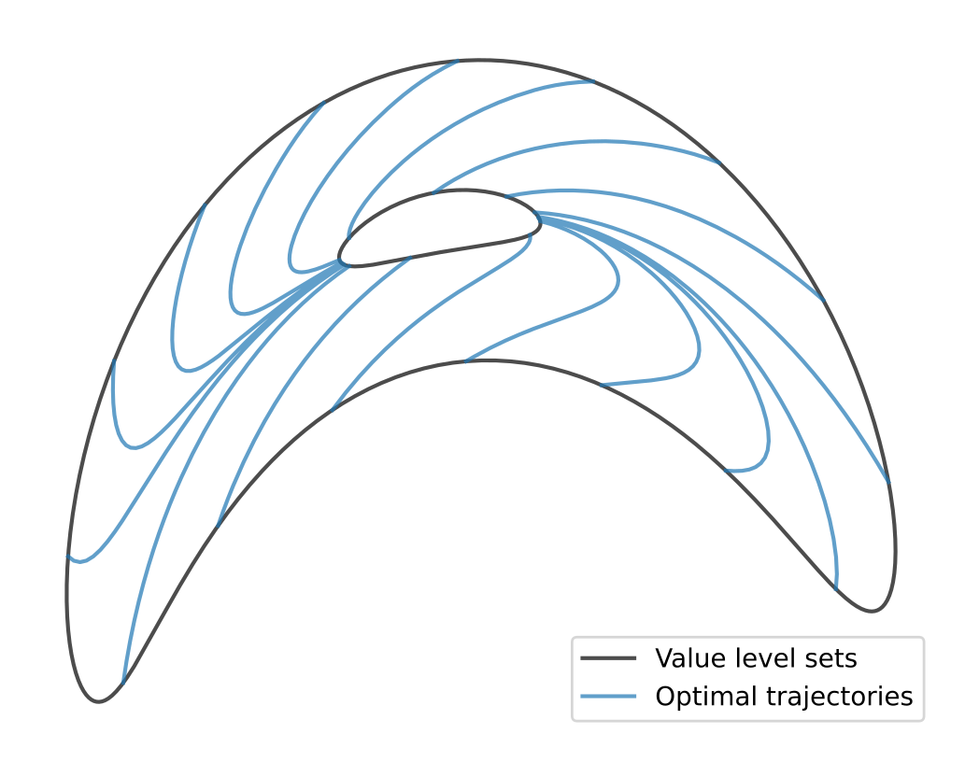
Trajectory Generation

Slide 12



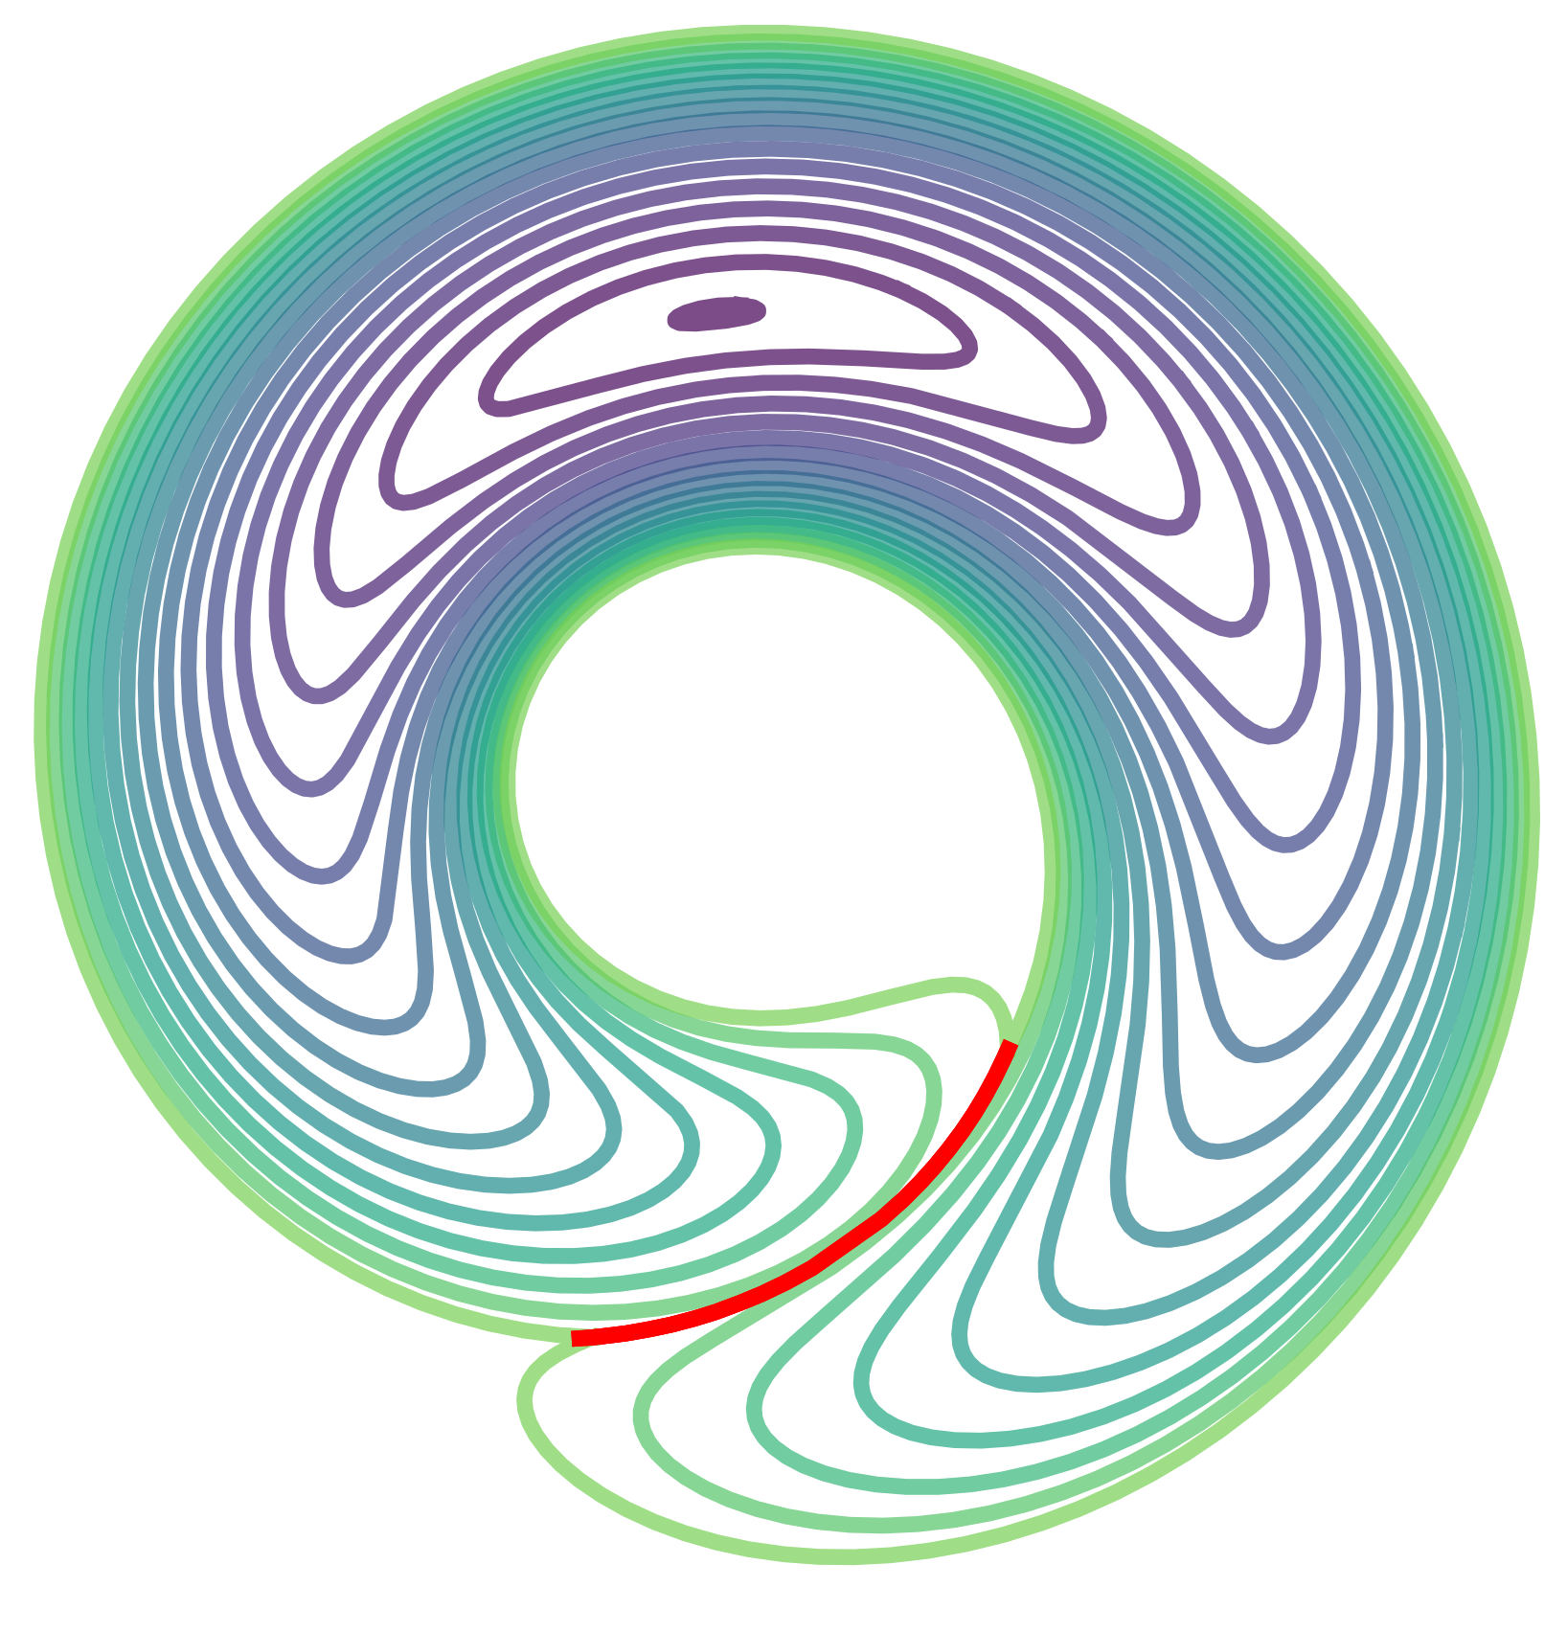
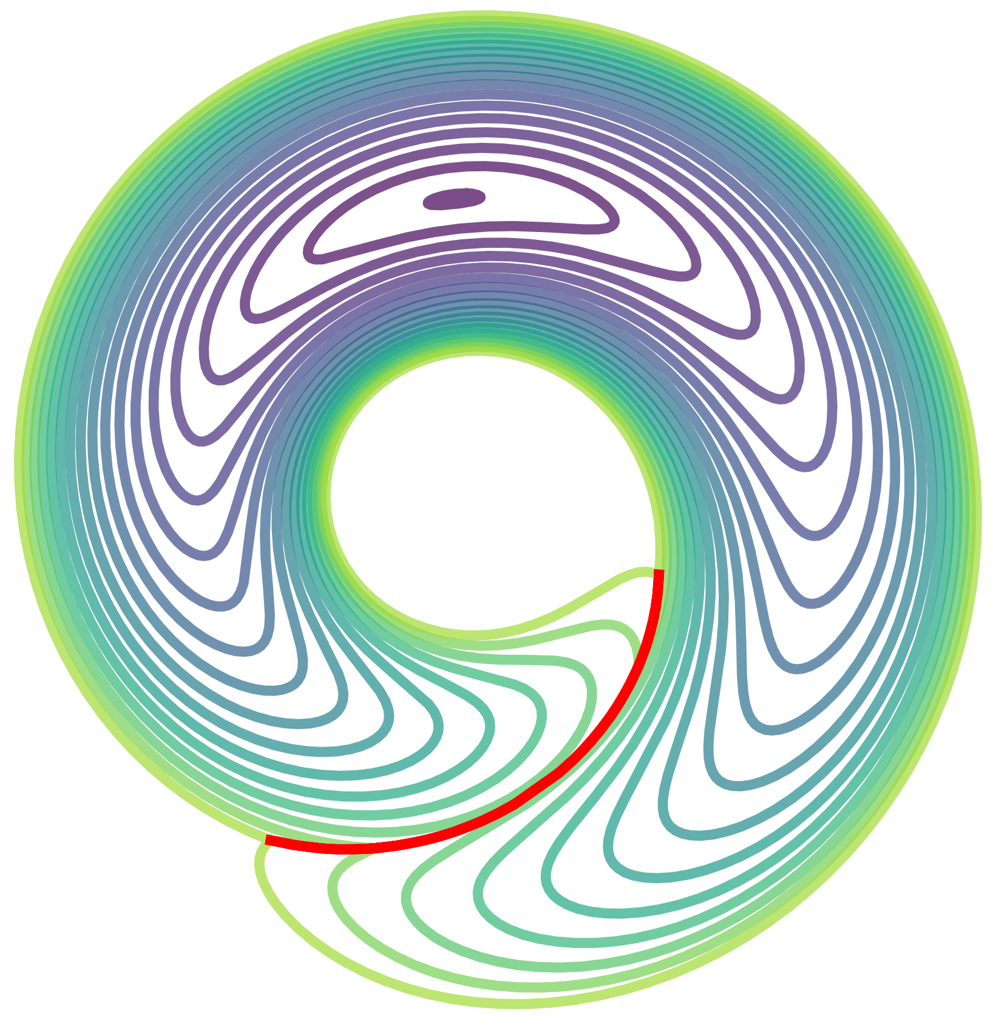
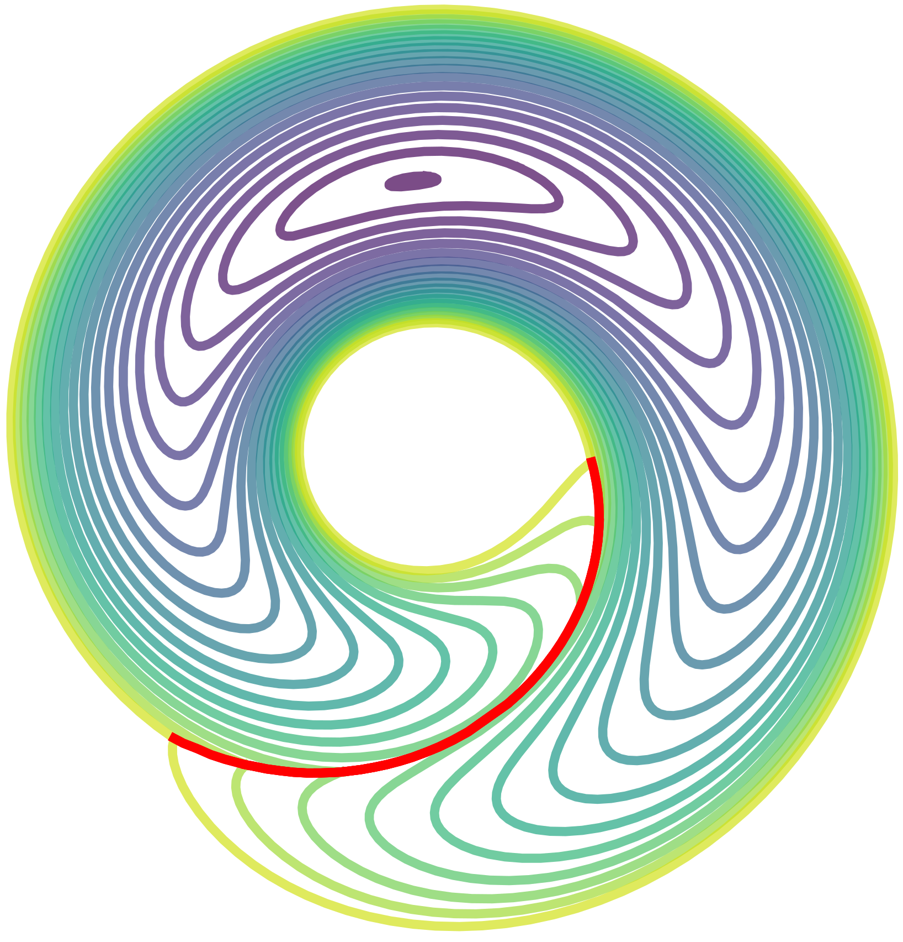
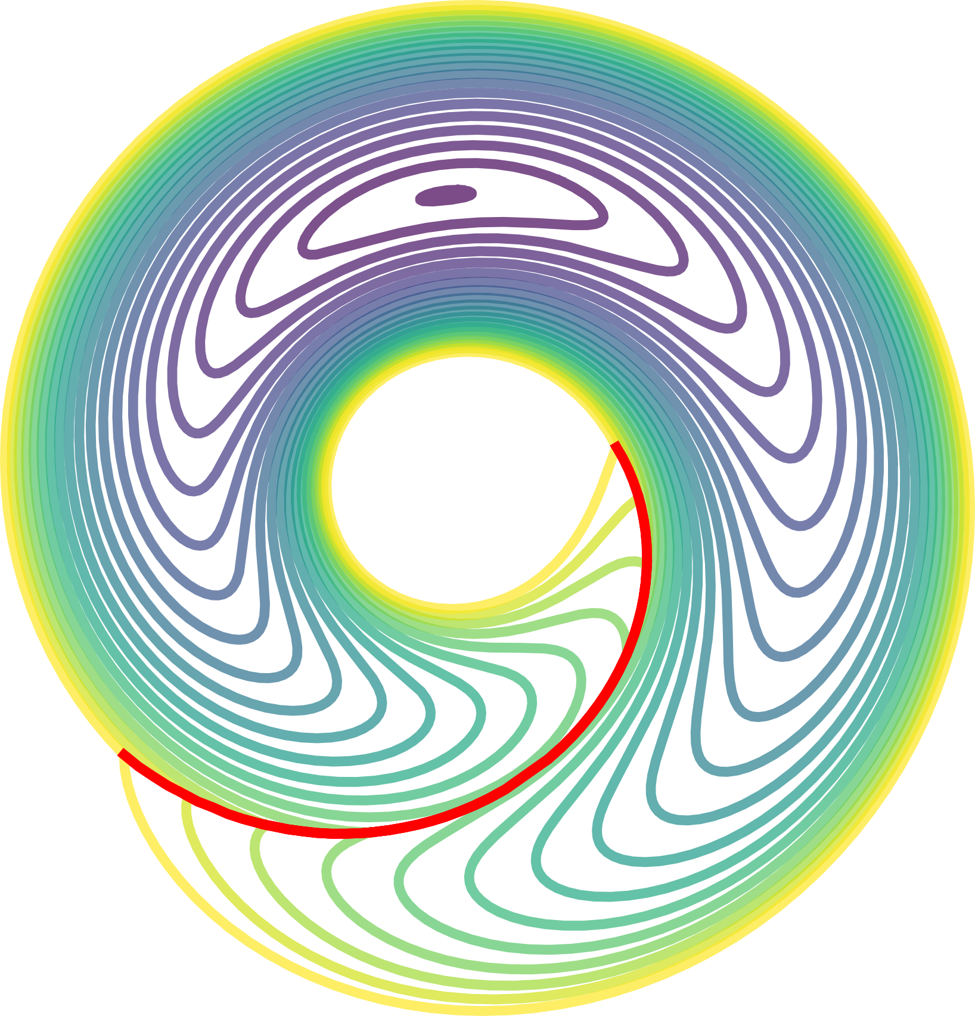
Why value level sets?

Slide 13
In Practice:
Finite data
Uncertain function approximation
Notes:
→ where to generate new data?
→ when are we happy w uncertainty?

Slide 14
Ideas from Active Learning
Function approximation with uncertainty estimate
  Simple NN ensemble
Uncertainty sampling
  Generate new data point where uncertainty estimate is high
Uncertainty threshold
  Every point with uncertainty below threshold is considered “known”
Notes:
Probably smarter than this mess: here VERY high level overview (what are the goals of the active learning things?)
Then in the algo exposé later, say what the different components do. But also skip over unimportant details.
Not more detail!

Slide 15
6D “Flat quad” system
.
θ → (sin θ, cos θ) to avoid wrapping
6D submanifold of ℝ⁷
θ, θ
u₁
.
u₂
y, y
mg
.
x, x

Slide 16
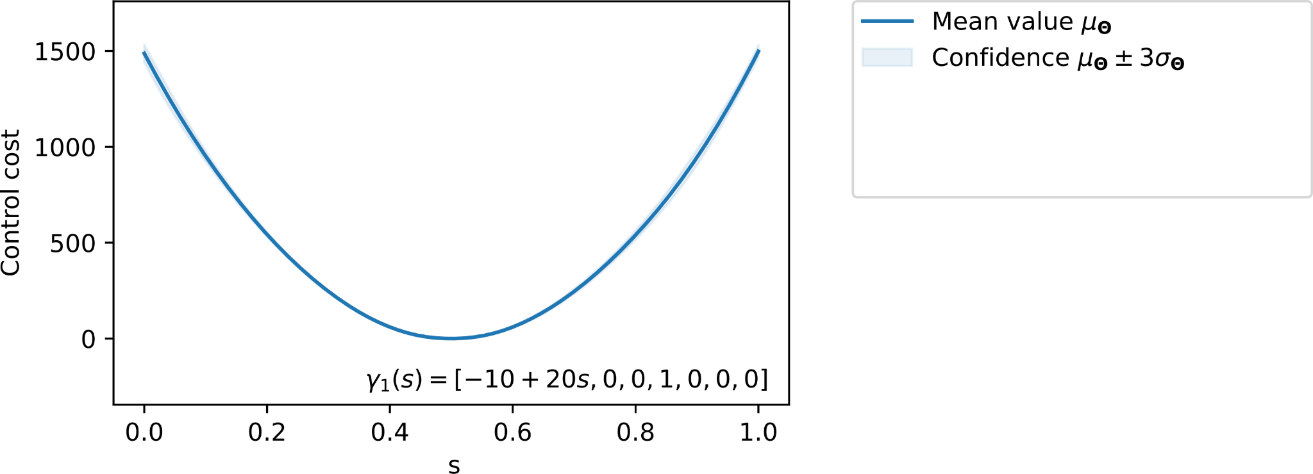
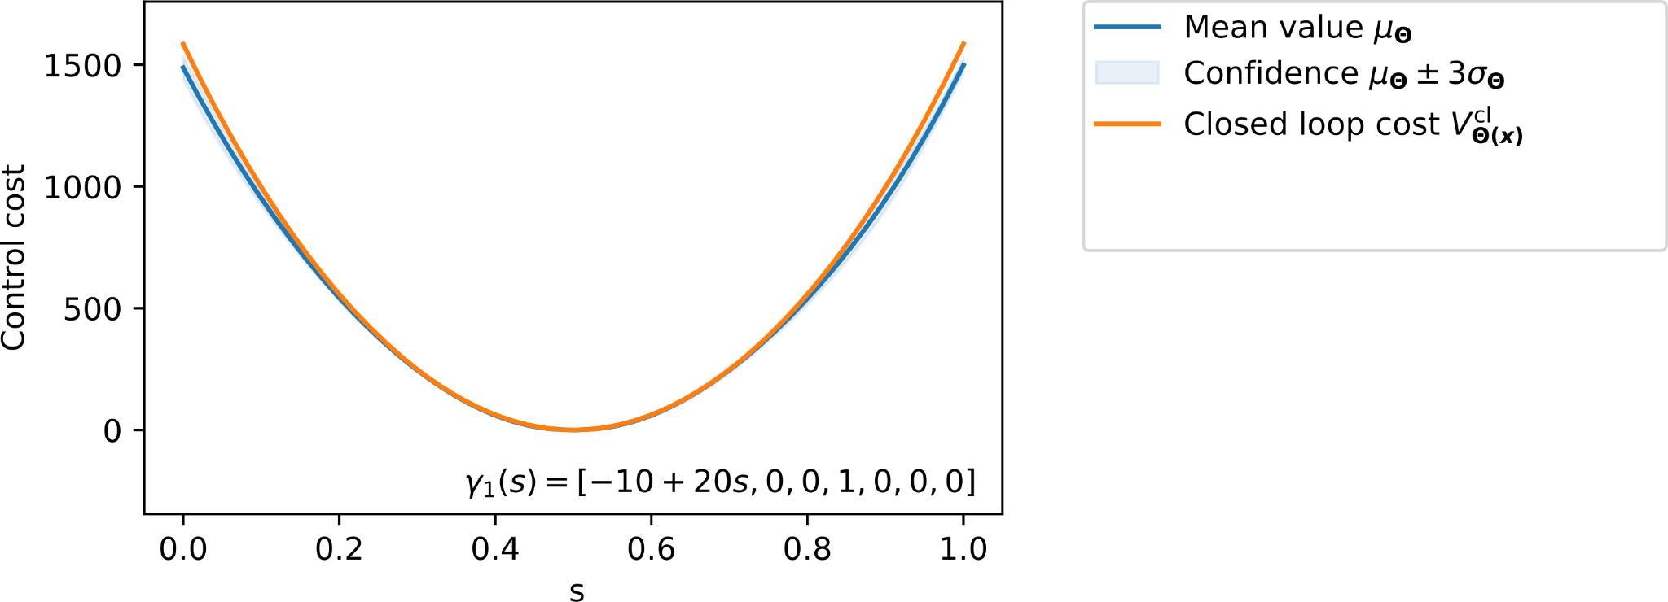
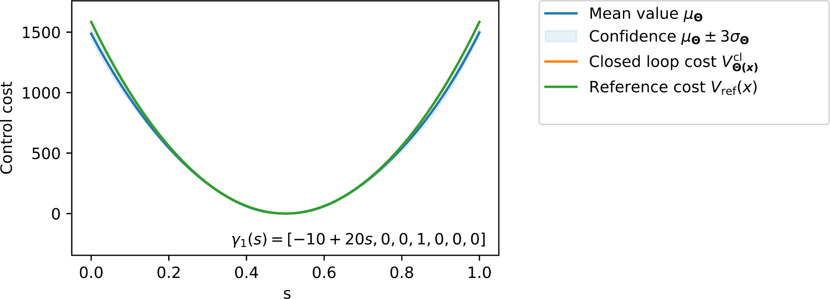
Results (6D system)
Notes:
Axis labels everytime

Slide 17
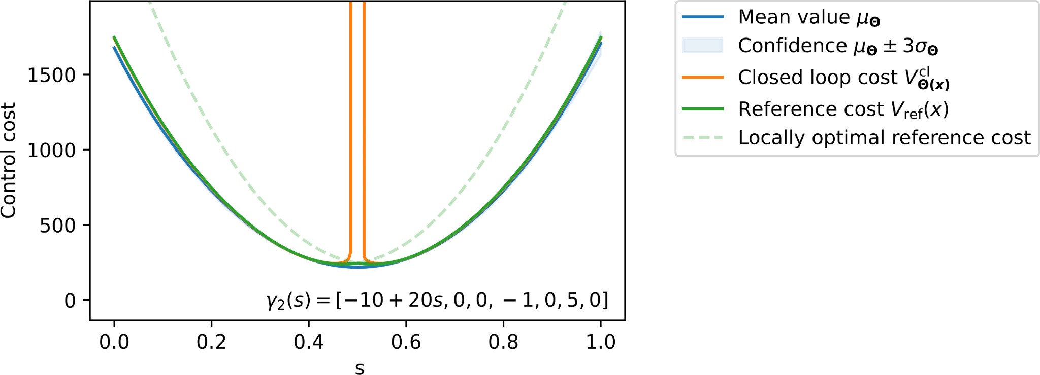
Results (6D system)
Notes:
Axis labels everytime

Slide 18
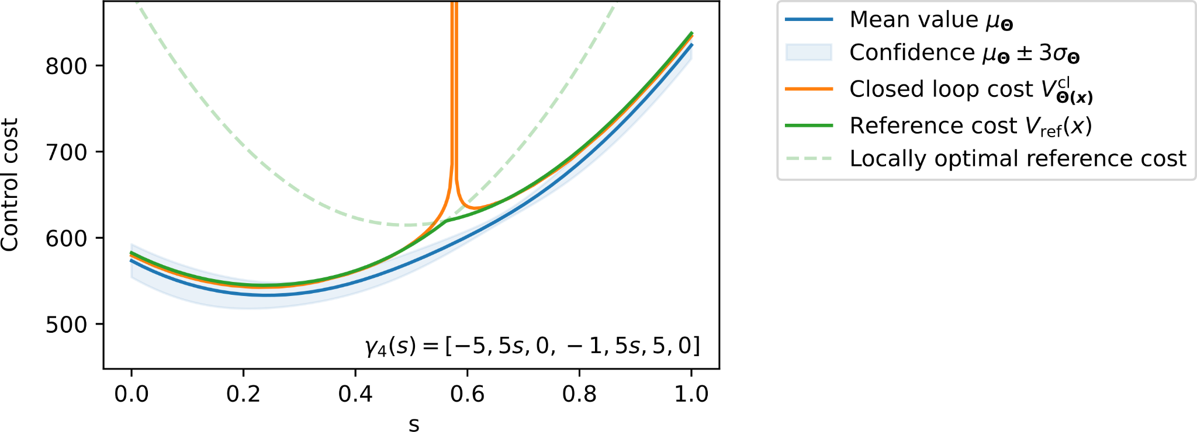
Results (6D system)
Notes:
Axis labels everytime

Slide 19
Conclusions
Proposed method does accurately solve continuous-time problems
Accuracy deteriorates where V is nonsmooth and control discontinuous
Further Research:
  Function approximation capable of nonsmoothness
  More general problem settings (State constraints, robust control, …)
  Scalability to larger systems, computational efficiency
  Concrete error analysis

Slide 20
Questions?

Slide 22

Bonus material

Slide 23
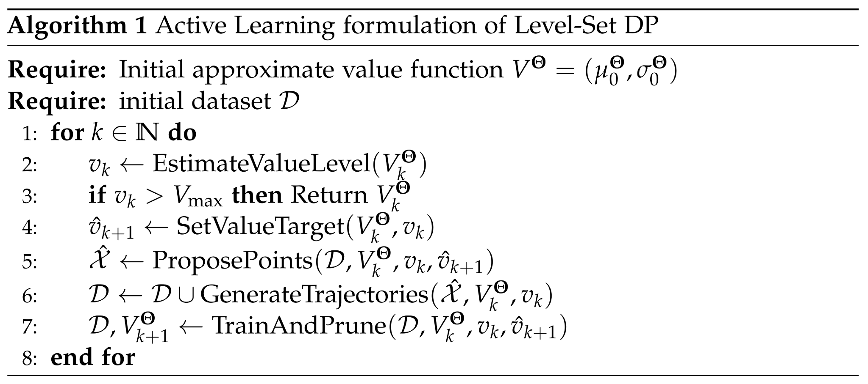
Notes:
Make each line appear separately
Think about max 3 sentences to describe each line.
Maybe this slide just too much doe

Slide 24
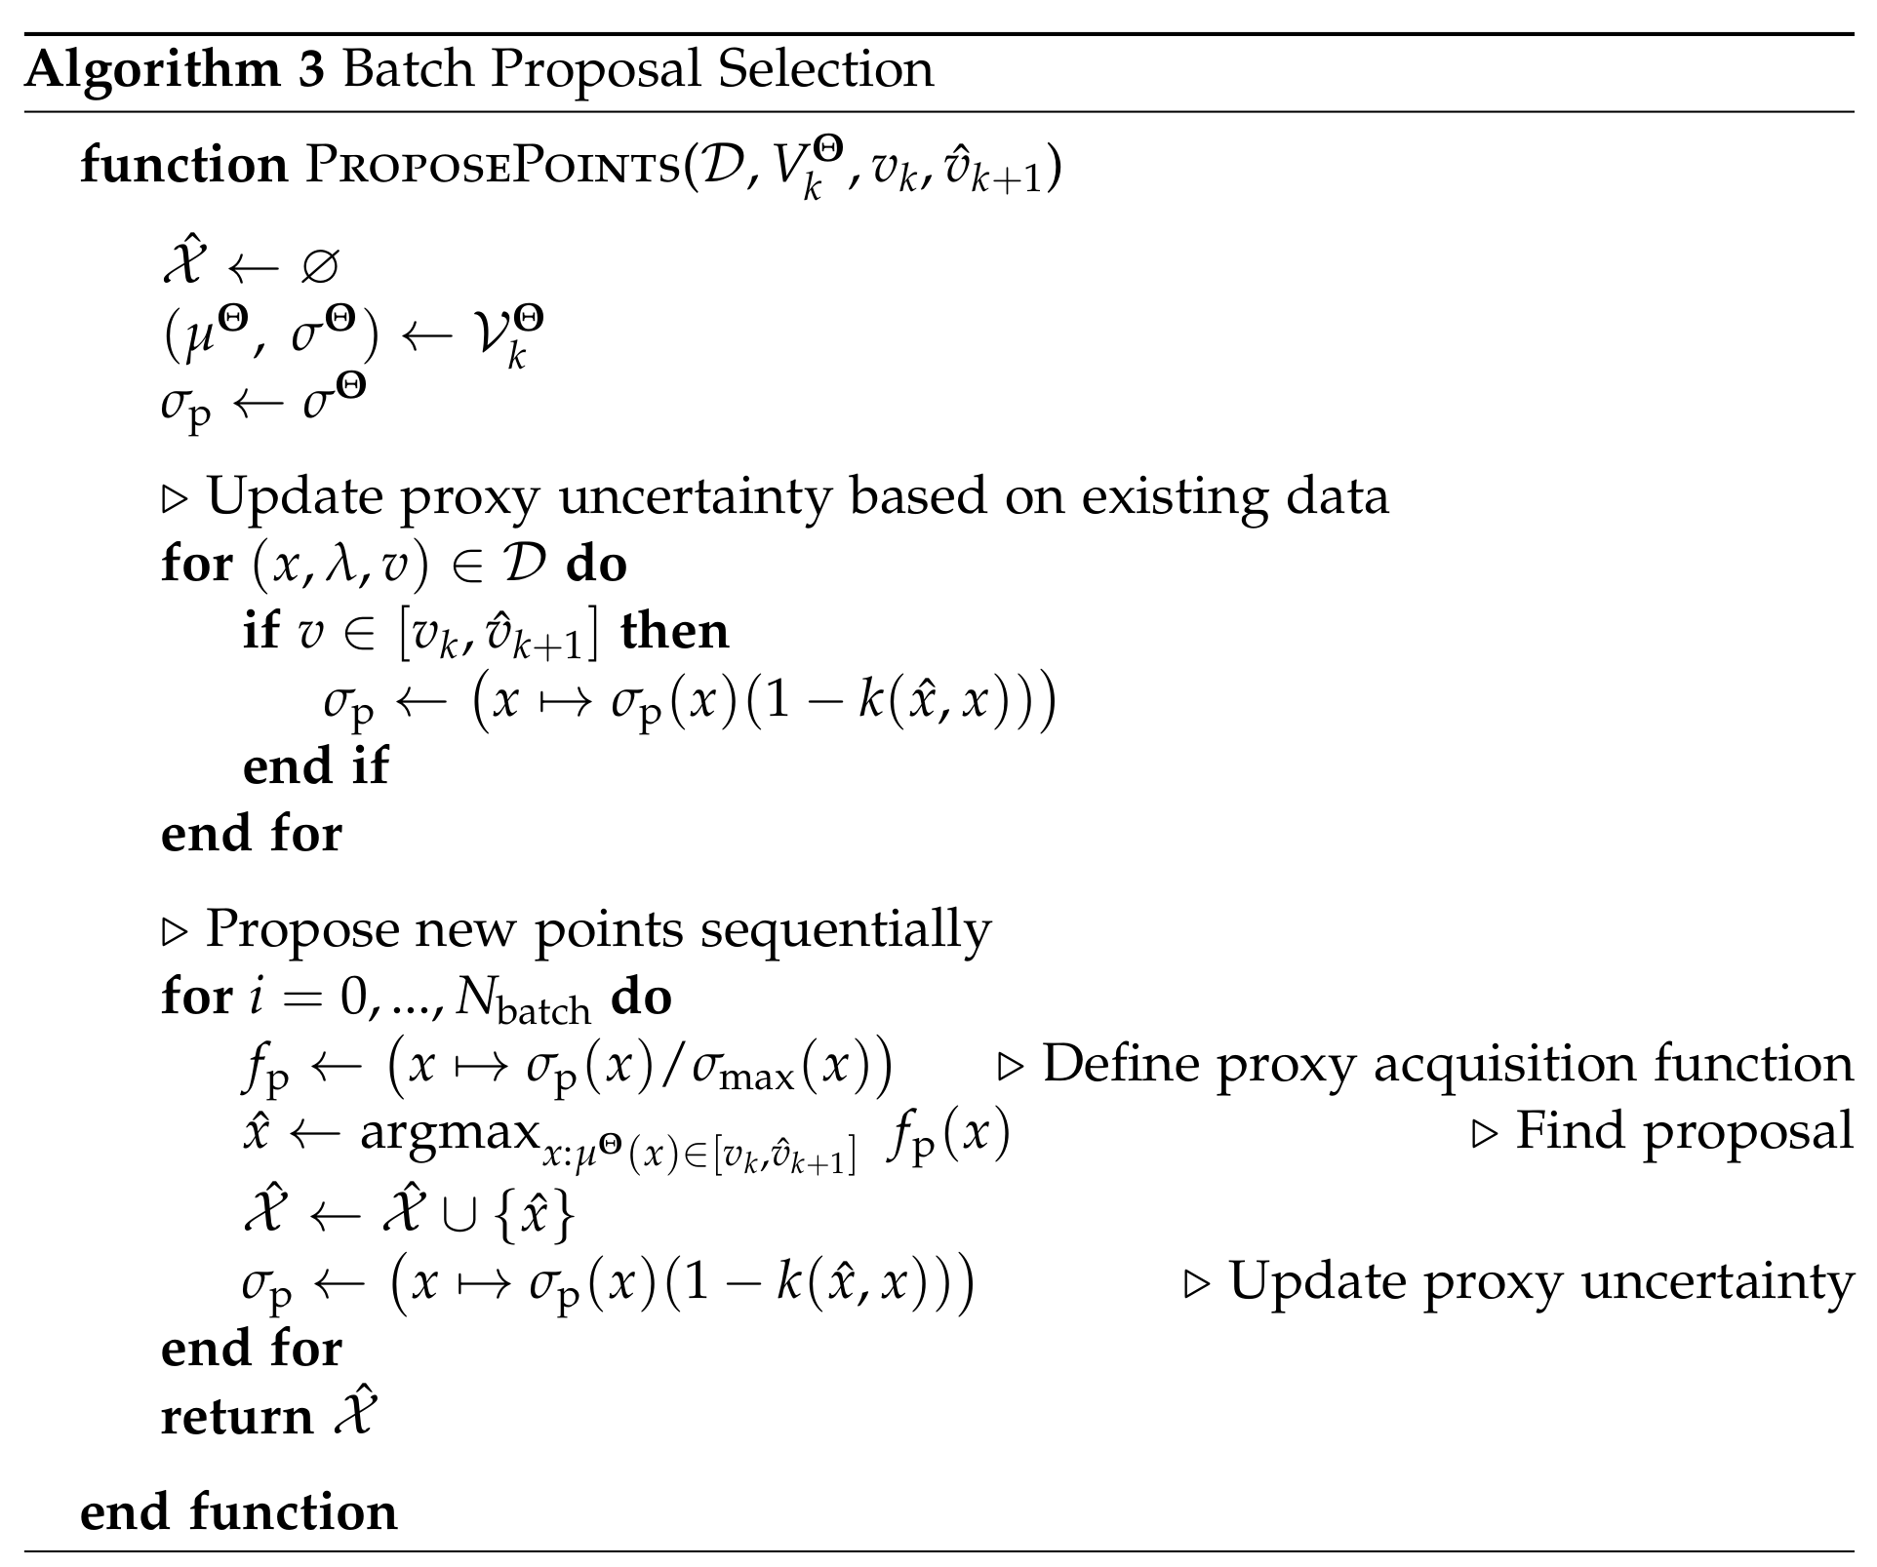

Slide 25
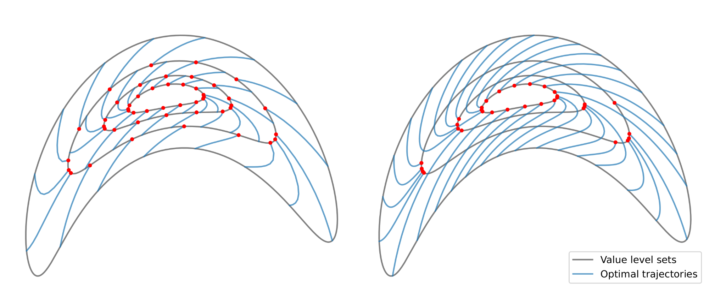

Slide 26
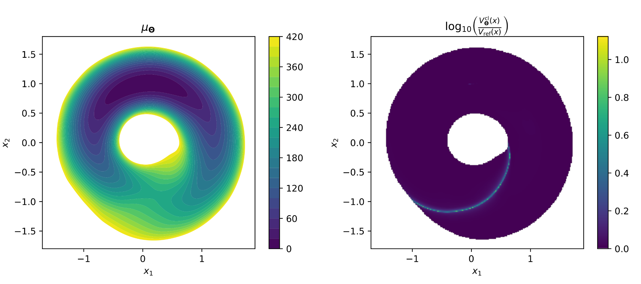
Results (2D system)
Notes:
Before this: slide that introduces toy system?
Skip over 2d system entirely? (thinking yes. It does not convey additional important points)

